Slide 1
SPEEDTRONICTM MARK VI CONTROL SYSTEM
Report by Gopala Krishna

Slide 2
SPEEDTRONICTM Mark VI Control
Contains: A number of control, protection and sequencing systems – GT control requirements are met using using these (A generator drive gas turbine is used as the reference during explanation)
Designed for: Reliable and safe operation of the gas turbine.
A generator drive gas turbine is used as the reference.

Slide 3
CONTROL SYSTEM
Basic Design
Control of the gas turbine is done by the:
Startup
Acceleration
Speed
Temperature
Shutdown
Manual control functions

Slide 4
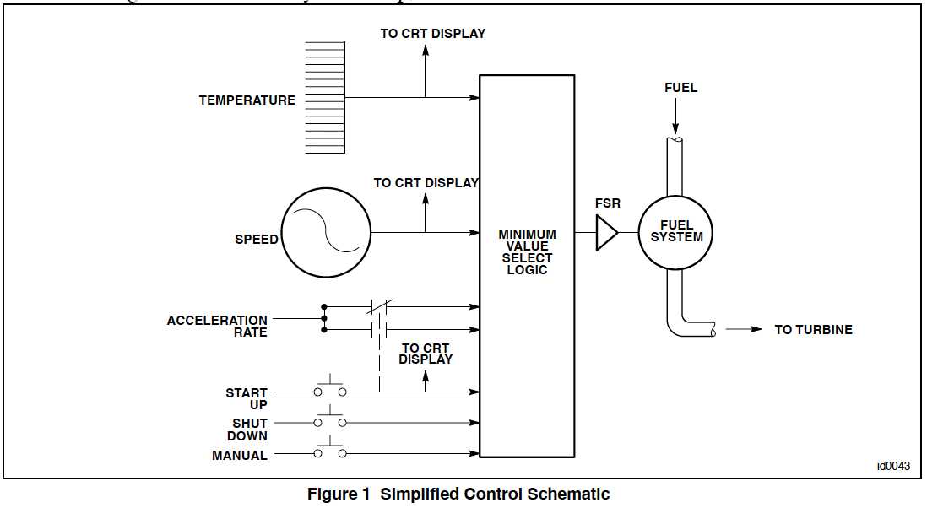
Basic Design: Control Schematic

Slide 5
Basic Design
Sensors monitor:
Turbine speed
Exhaust temperature
Compressor discharge pressure
Other parameters
To determine the operating conditions of the unit.
When it is necessary to alter the turbine operating conditions because of changes in load or ambient conditions, the control modulates the flow of fuel to the gas turbine.
For example, if the exhaust temperature tends to exceed its allowable value for a given operating condition, the temperature control system reduces the fuel supplied to the turbine and thereby limits the exhaust temperature.

Slide 6
Basic Design
Operating conditions of the turbine are sensed and utilized as feedback signals to the SPEEDTRONIC control system.
There are 3 major control loops –
Startup
Speed
Temperature – which may be in control during turbine operation.
The output of these control loops is connected to a minimum value gate circuit (Figure 1).
The secondary control modes of acceleration, manual FSR, and shutdown operate in a similar manner.

Slide 7
Basic Design
Fuel Stroke Reference (FSR) is the command signal for fuel flow.
The minimum value select gate connects the output signals of the six control modes to the FSR controller.
The lowest FSR output of the six control loops is allowed to pass through the gate to the fuel control system as the controlling FSR.
The controlling FSR will establish the fuel input to the turbine at the rate required by the system which is in control.
Only one control loop will be in control at any particular time and the control loop which is controlling FSR will be displayed on the <HMI>. (Figure 2 – detailed schematic of the control loops to the interfacing)

Slide 8
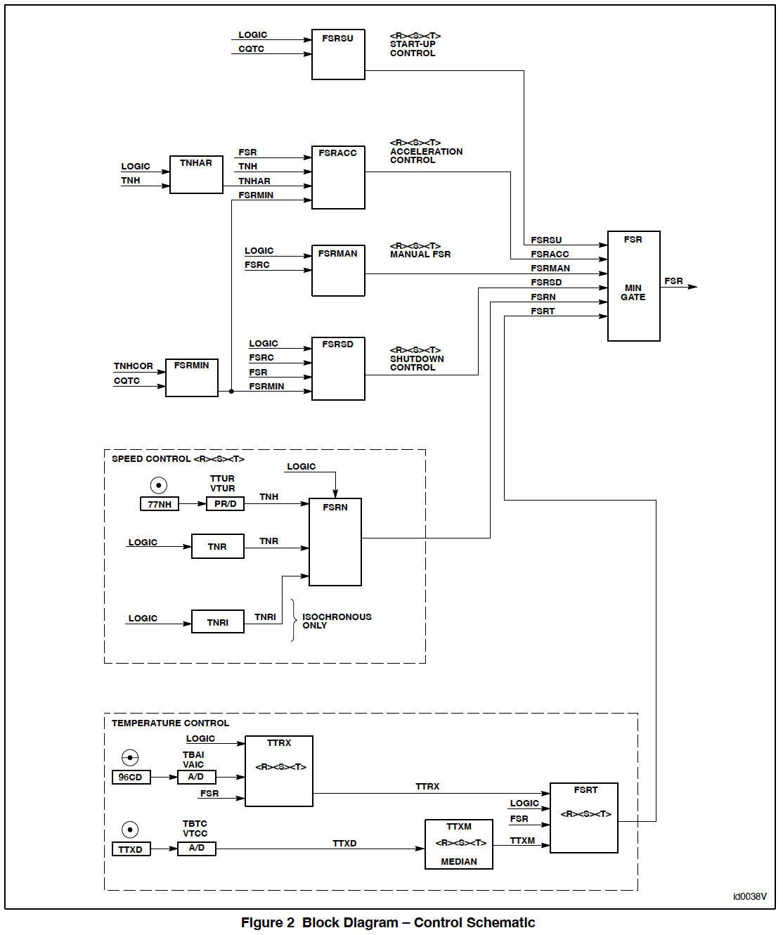

Slide 9
Start–up/Shutdown Sequence and Control
Start–up control brings the gas turbine from zero speed up to operating speed safely by providing proper fuel to establish flame, accelerate the turbine, and to do it in such a manner as to minimize the low cycle fatigue of the hot gas path parts during the sequence.
This involves proper sequencing of command signals to the accessories, starting device and fuel control system.
Since a safe and successful start–up depends on proper functioning of the gas turbine equipment, it is important to verify the state of selected devices in the sequence.

Slide 10
Start–up/Shutdown Sequence and Control
Much of the control logic circuitry is associated not only with actuating control devices, but enabling protective circuits and obtaining permissive conditions before proceeding.
The gas turbine uses a static start system whereby the generator serves as a starting motor.
A turning gear is used for rotor breakaway.
Actual values for control settings are given in the Control Specifications for a particular machine.

Slide 11
Speed Detectors
An important part of the start–up/shutdown sequence control of the gas turbine is proper speed sensing.
Turbine speed is measured by magnetic pickups.
The speed detectors and speed relays that are typically used:
L14HR Zero–Speed (approx. 0% speed)
L14HM Minimum Speed (approx. 16% speed)
L14HA Accelerating Speed (approx. 50% speed)
L14HS Operating Speed (approx. 95% speed)

Slide 12
Speed Detectors [conti.]
The zero–speed detector, L14HR, provides the signal when the turbine shaft starts or stops rotating.
When the shaft speed is below 14HR, or at zero–speed, L14HR picks–up (fail safe) and the permissive logic initiates turning gear or slow–roll operation during the automatic start–up sequence of the turbine.
The minimum speed detector L14HM indicates that the turbine has reached the minimum firing speed and initiates the purge cycle prior to the introduction of fuel and ignition.
The dropout of the L14HM minimum speed relay provides several permissive functions in the restarting of the gas turbine after shutdown.

Slide 13
Speed Detectors [conti.]
The accelerating speed relay L14HA pickup indicates when the turbine has reached approximately 50 percent speed; this indicates that turbine start–up is progressing and keys certain protective features.
The high–speed sensor L14HS pickup indicates when the turbine is at speed and that the accelerating sequence is almost complete.
This signal provides the logic for various control sequences such as stopping auxiliary lube oil pumps and starting turbine shell/exhaust frame blowers.

Slide 14
Speed Detectors [conti.]
Should the turbine and generator slow during an underfrequency situation, L14HS will drop out at the under–frequency speed setting. After L14HS drops out the generator breaker will trip open and the Turbine Speed Reference (TNR) will be reset to 100.3%.
As the turbine accelerates, L14HS will again pick up; the turbine will then require another
start signal before the generator will attempt to auto–synchronize to the system again.
The actual settings of the speed relays are listed in the Control Specification and are programmed in the <RST> processors as EEPROM control constants.

Slide 15
START–UP CONTROL
The start–up control operates as an open loop control using preset levels of the fuel command signal FSR.
The levels are: “ZERO”, “FIRE”, “WARM–UP”, “ACCELERATE” and “MAX”.
The Control Specifications provide proper settings calculated for the fuel anticipated at the site.
The FSR levels are set as Control Constants in the SPEEDTRONIC Mark VI start–up control.
Start–up control FSR signals operate through the minimum value gate to ensure that other control functions can limit FSR as required.

Slide 16
START–UP CONTROL [conti.]
The fuel command signals are generated by the SPEEDTRONIC control start–up software.
In addition to the three active start–up levels, the software sets maximum and minimum FSR and provides for manual control of FSR.
Clicking on the targets for “MAN FSR CONTROL” and “FSR GAG RAISE OR LOWER” allows manual adjustment of FSR setting between FSRMIN and FSRMAX.
While the turbine is at rest, electronic checks are made of the fuel system stop and control valves, the accessories, and the voltage supplies. At this time, “SHUTDOWN STATUS” will be displayed on the <HMI>.

Slide 17
START–UP CONTROL [conti.]
Activating the Master Operation Switch (L43) from “OFF” to an operating mode will activate the ready circuit. If all protective circuits and trip latches are reset, the “STARTUP STATUS” and “READY TO START” messages will be displayed, indicating that the turbine will accept a start signal.
Clicking on the “START” Master Control Switch (L1S) and “EXECUTE” will introduce the start signal to the logic sequence.
The start signal energizes the Master Control and Protection circuit (the “L4” circuit) and starts the necessary auxiliary equipment. The “L4” circuit permits pressurization of the trip oil system. With the “L4” circuit permissive and starting clutch automatically engaged, the starting device starts turning. Startup status message “STARTING” will be displayed on the <HMI>. Point “A” on the Typical Start–up Curve.

Slide 18
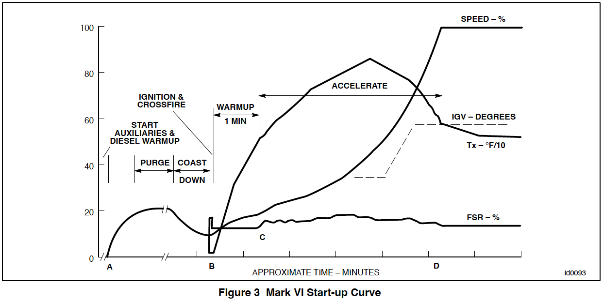

Slide 19
START–UP CONTROL [conti.]
The starting clutch is a positive tooth type overrunning clutch which is self–engaging in the breakaway mode and overruns whenever the turbine rotor exceeds the turning gear speed.
When the turbine ‘breaks away’ the turning gear will rotate the turbine rotor from 5 to 7 rpm. As the static starter begins it’s sequence, and accelerates the rotor the starting clutch will automatically disengage the turning gear from the turbine rotor.
The turbine speed relay L14HM indicates that the turbine is turning at the speed required for proper purging and ignition in the combustors.
Gas fired units that have exhaust configurations which can trap gas leakage (i.e., boilers) have a purge timer, L2TV, which is initiated with the L14HM signal.

Slide 20
START–UP CONTROL [conti.]
The purge time is set to allow three to four changes of air through the unit to ensure that any combustible mixture has been purged from the system.
The starting means will hold speed until L2TV has completed its cycle.
Units which do not have extensive exhaust systems may not have a purge timer, but rely on the starting cycle and natural draft to purge the system.
The L14HM signal or completion of the purge cycle (L2TVX) ‘enables’ fuel flow, ignition, sets firing level FSR, and initiates the firing timer L2F – Point “B”.

Slide 21
START–UP CONTROL [conti.]
When the flame detector output signals indicate flame has been established in the combustors (L28FD), the warm–up timer L2W starts and the fuel command signal is reduced to the “WARM–UP” FSR level.
The warm–up time is provided to minimize the thermal stresses of the hot gas path parts during the initial part of the start–up.
If flame is not established by the time the L2F timer times out, typically 60 seconds, fuel flow is halted.
The unit can be given another start signal, but firing will be delayed by the L2TV timer to avoid fuel accumulation in successive attempts. This sequence occurs even on units not requiring initial L2TV purge.

Slide 22
START–UP CONTROL [conti.]
At the completion of the warm–up period (L2WX), the start–up control ramps FSR at a predetermined rate to the setting for “ACCELERATE LIMIT”.
The start–up cycle has been designed to moderate the highest firing temperature produced during acceleration. This is done by programming a slow rise in FSR – Point “C”.
As fuel is increased, the turbine begins the acceleration phase of start–up. The clutch is held in as long as the turning gear provides torque to the gas turbine. When the turbine overruns the turning gear, the clutch will disengage, shutting down the turning gear. Speed relay L14HA indicates the turbine is accelerating.

Slide 23
START–UP CONTROL [conti.]
The start–up phase ends when the unit attains full–speed–no–load ( Point “D”).
FSR is then controlled by the speed loop and the auxiliary systems are automatically shut down.
The start–up control software establishes the maximum allowable levels of FSR signals during start–up. Other control circuits are able to reduce and modulate FSR to perform their control functions.
In the acceleration phase of the start–up, FSR control usually passes to acceleration control, which monitors the rate of rotor acceleration. It is possible, but not normal, to reach the temperature control limit. The <HMI> display will show which parameter is limiting or controlling FSR.

Slide 24
Fired Shutdown
A normal shutdown is initiated by clicking on the “STOP” target (L1STOP) and “EXECUTE”; this will produce the L94X signal.
If the generator breaker is closed when the stop signal is initiated, the Turbine Speed Reference (TNR) counts down to reduce load at the normal loading rate until the reverse power relay operates to open the generator breaker; TNR then continues to count down to reduce speed.
When the STOP signal is given, shutdown Fuel Stroke Reference FSRSD is set equal to FSR. When the generator breaker opens, FSRSD ramps from existing FSR down to a value equal to FSRMIN, the minimum fuel required to keep the turbine fired. FSRSD latches onto FSRMIN and decreases with corrected speed.

Slide 25
Fired Shutdown [conti.]
When turbine speed drops below a defined threshold (Control Constant K60RB) FSRSD ramps to a blowout of one flame detector. The sequencing logic remembers which flame detectors were functional when the breaker opened. When any of the functional flame detectors senses a loss of flame, FSRMIN/FSRSD decreases at a higher rate until flame–out occurs, after which fuel flow is stopped.
Fired shut down is an improvement over the former fuel shut off at L14HS drop out. By maintaining flame down to a lower speed there is significant reduction in the strain developed on the hot gas path parts at the time of fuel shut off.

Slide 26
SPEED CONTROL

Slide 27
SPEED CONTROL
The Speed Control System controls the speed and load of the gas turbine generator in response to the actual turbine speed signal and the called–for speed reference.
While on speed control the control mode message “SPEED CTRL” will be displayed.

Slide 28
Speed Signal
Three magnetic sensors are used to measure the speed of the turbine.
These magnetic pickup sensors (77NH–1,–2,–3) are high output devices consisting of a permanent magnet surrounded by a hermetically sealed case.
The pickups are mounted in a ring around a 60–toothed wheel on the gas turbine compressor rotor. With the 60–tooth wheel, the frequency of the voltage output in Hertz is exactly equal to the speed of the turbine in revolutions per minute.
The voltage output is affected by the clearance between the teeth of the wheel and the tip of the magnetic pickup.

Slide 29
Speed Signal [conti.]
Clearance between the outside diameter of the toothed wheel and the tip of the magnetic pickup should be kept within the limits specified in the Control Specifications (approx. 0.05 inch or 1.27 mm).
If the clearance is not maintained within the specified limits, the pulse signal can be distorted. Turbine speed control would then operate in response to the incorrect speed feedback signal.
The signal from the magnetic pickups is brought into the Mark VI panel, one mag pickup to each controller <RST>, where it is monitored by the speed control software.

Slide 30
Speed/Load Reference
The speed control software will change FSR in proportion to the difference between the actual turbine–generator speed (TNH) and the called–for speed reference (TNR).
The called–for–speed, TNR, determines the load of the turbine.
The range for generator drive turbines is normally from 95% (min.) to 107% (max.) speed.
The start–up speed reference is 100.3% and is preset when a “START” signal is given.
The turbine follows to 100.3% TNH for synchronization.

Slide 31
Speed/Load Reference [conti.]
At this point the operator can raise or lower TNR, in turn raising or lowering TNH, via the 70R4CS switch on the generator control panel or by clicking on the targets on the <HMI>, if required.(Figure 4)
Once the generator breaker is closed onto the power grid, the speed is held constant by the grid frequency.
Fuel flow in excess of that necessary to maintain full speed no load will result in increased power produced by the generator. Thus the speed control loop becomes a load control loop and the speed reference is a convenient control of the desired amount of load to be applied to the turbine–generator unit.
Droop speed control is a proportional control, changing FSR in proportion to the difference between actual turbine speed and the speed reference.
Any change in actual speed (grid frequency) will cause a proportional change in unit load. This proportionality is adjustable to the desired regulation or “Droop”. (The speed vs. FSR relationship is shown on Figure 4)

Slide 32
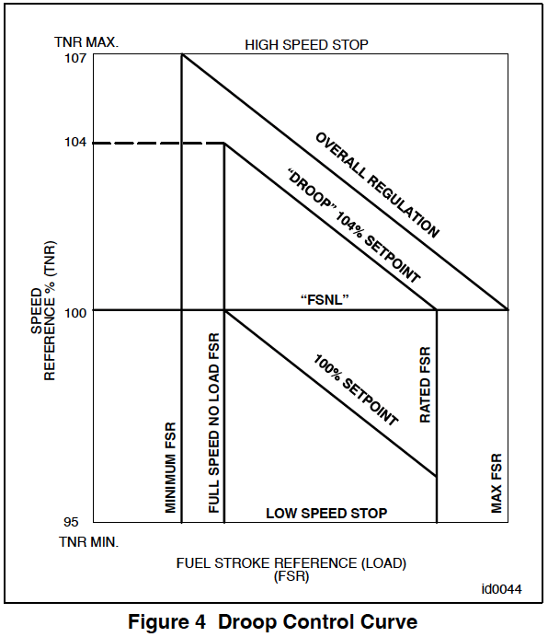

Slide 33
Speed/Load Reference [conti.]
If the entire grid system tends to be overloaded, grid frequency (or speed) will decrease and cause an FSR increase in proportion to the droop setting.
If all units have the same droop, all will share a load increase equally. Load sharing and system stability are the main advantages of this method of speed control.
Normally 4% droop is selected and the setpoint is calibrated such that 104% setpoint will generate a speed reference which will produce an FSR resulting in base load at design ambient temperature.

Slide 34
Speed/Load Reference [conti.]
When operating on droop control, the full–speed–no–load FSR setting calls for a fuel flow which is sufficient to maintain full speed with no generator load.
By closing the generator breaker and raising TNR via raise/lower, the error between speed and reference is increased.
This error is multiplied by a gain constant dependent on the desired droop setting and added to the FSNL FSR setting to produce the required FSR to take more load and thus assist in holding the system frequency. (Refer to Figures 4 and 5)

Slide 35
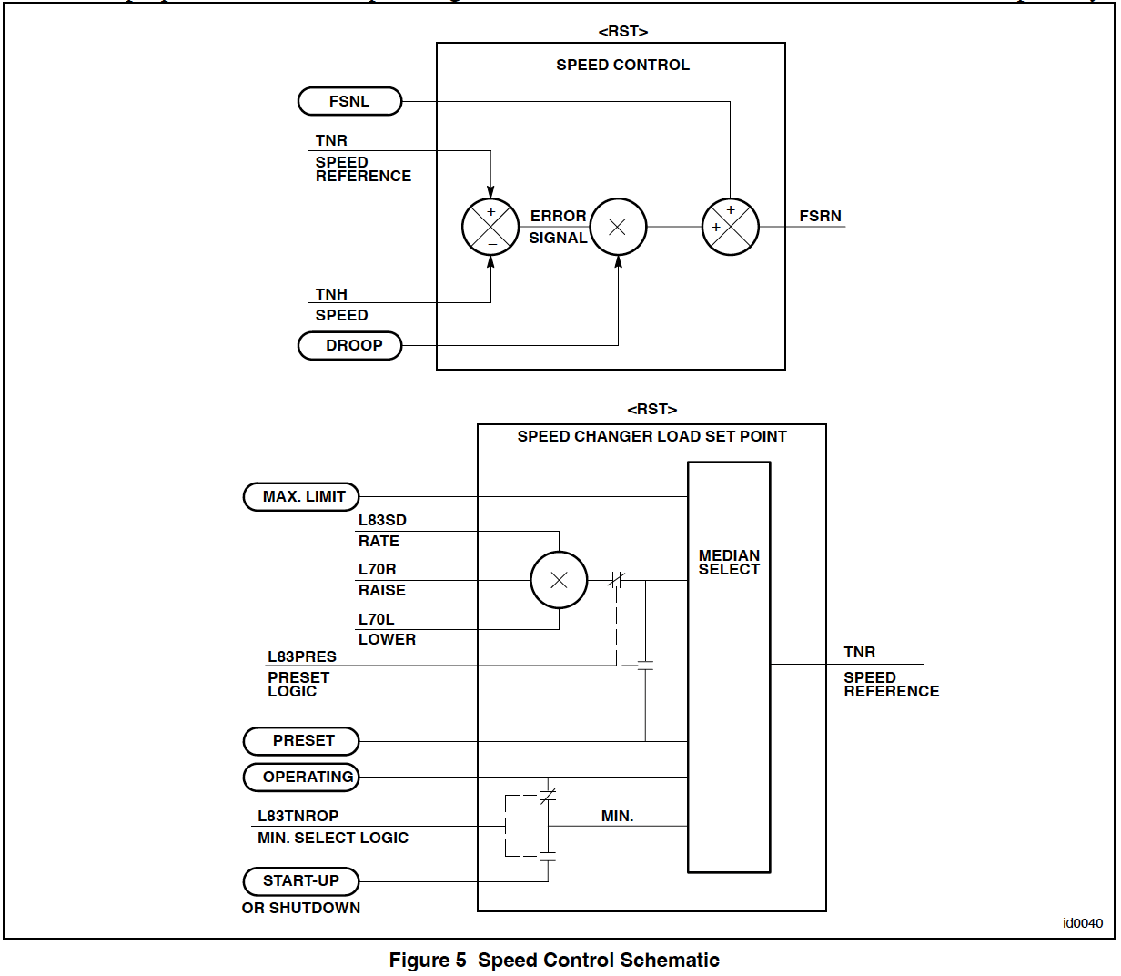

Slide 36
Speed/Load Reference [conti.]
The minimum FSR limit (FSRMIN) in the SPEEDTRONIC Mark VI system prevents the speed control circuits from driving the FSR below the value which would cause flameout during a transient condition.
For example, with a sudden rejection of load on the turbine, the speed control system loop would want to drive the FSR signal to zero, but the minimum FSR setting establishes the minimum fuel level that prevents a flameout.
Temperature and/or start–up control can drive FSR to zero and are not influenced by FSRMIN.

Slide 37
Synchronizing
Automatic synchronizing is accomplished using synchronizing algorithms programmed into <RST> and <VPRO> software.
Bus and generator voltage signals are input to the <VPRO> core
Which contains isolation transformers, and are then paralleled to <RST>.
<RST> software drives the synch check and synch permissive relays, while <VPRO> provides the actual breaker close command.

Slide 38
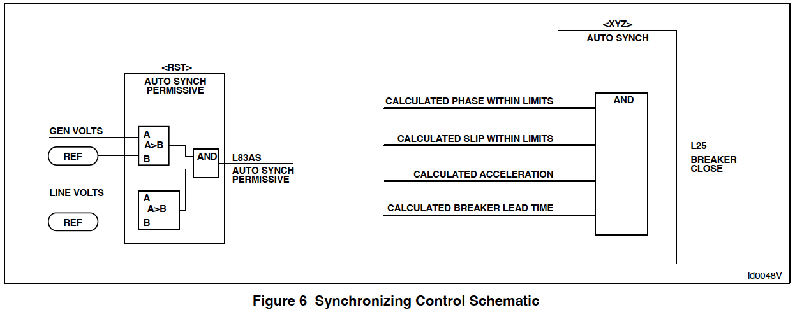

Slide 39
Synchronizing [conti.]
There are three basic synchronizing modes.
These may be selected from external contacts, i.e., generator panel selector switch, or from the SPEEDTRONIC Mark VI <HMI>.
OFF – Breaker will not be closed by SPEEDTRONIC Mark VI control
MANUAL – Operator initiated breaker closure when permissive synch check relay 25X is satisfied
AUTO – System will automatically match voltage and speed and then close the breaker at the appropriate time
To hit top dead center on the synchroscope

Slide 40
Synchronizing [conti.]
For synchronizing, the unit is brought to 100.3% speed to keep the generator “faster” than the grid, assuring load pick–up upon breaker closure.
If the system frequency has varied enough to cause an unacceptable slip frequency (difference between generator frequency and grid frequency), the speed matching circuit adjusts TNR to maintain turbine speed 0.20% to 0.40% faster than the grid
To assure the correct slip frequency and permit synchronizing.
For added protection a synchronizing check relay is provided in the generator panel.
Used in series with both the auto synchronizing relay and the manual breaker close switch
To prevent large out–of–phase breaker closures.

Slide 41
ACCELERATION CONTROL

Slide 42
ACCELERATION CONTROL
Acceleration control compares the present value of the speed signal with the value at the last sample time. The difference between these two numbers is a measure of the acceleration.
If the actual acceleration is greater than the acceleration reference, FSRACC is reduced, which will reduce FSR, and consequently the fuel to the gas turbine.
During start–up the acceleration reference is a function of turbine speed; acceleration control usually takes over from speed control shortly after the warm–up period and brings the unit to speed.
At “Complete Sequence”, which is normally 14HS pick–up, the acceleration reference is a Control Constant, normally 1% speed/second.
After the unit has reached 100% TNH, acceleration control usually serves only to contain the unit’s speed if the generator breaker should open while under load.

Slide 43
TEMPERATURE CONTROL

Slide 44
TEMPERATURE CONTROL
The Temperature Control System will limit fuel flow to the gas turbine to maintain internal operating temperatures within design limitations of turbine hot gas path parts.
The highest temperature in the gas turbine occurs in the flame zone of the combustion chambers.
The combustion gas in that zone is diluted by cooling air and flows into the turbine section through the first stage nozzle.
The temperature of that gas as it exits the first stage nozzle is known as the “firing temperature” of the gas turbine; it is this temperature that must be limited by the control system.

Slide 45
TEMPERATURE CONTROL [conti.]
From thermodynamic relationships, gas turbine cycle performance calculations, and known site conditions, firing temperature can be determined as a function of exhaust temperature and the pressure ratio across the turbine; the latter is determined from the measured compressor discharge pressure (CPD).
The temperature control system is designed to measure and control turbine exhaust temperature rather than firing temperature because it is impractical to measure temperatures directly in the combustion chambers or at the turbine inlet.
This indirect control of turbine firing temperature is made practical by utilizing known gas turbine aero– and thermo–dynamic characteristics and using those to bias the exhaust temperature signal, since the exhaust temperature alone is not a true indication of firing temperature.

Slide 46
TEMPERATURE CONTROL [conti.]
Firing temperature can also be approximated as a function of exhaust temperature and fuel flow (FSR) and as a function of exhaust temperature and generator output (DWATT). Either FSR or megawatt exhaust temperature control curves are used as back–up to the primary CPD–biased temperature control curve.
(These relationships are shown on Figures 7 and 8.)
The lines of constant firing temperature are used in the control system to limit gas turbine operating temperatures, while the constant exhaust temperature limit protects the exhaust system during start–up.

Slide 47
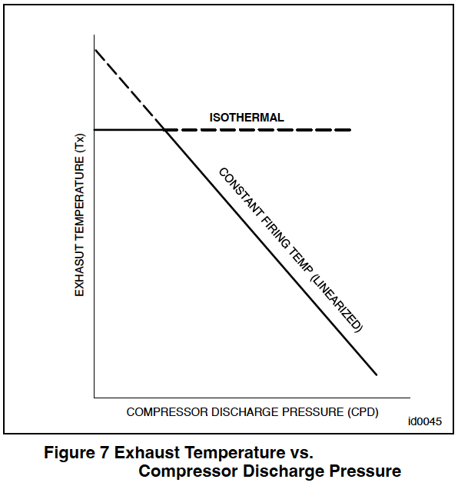
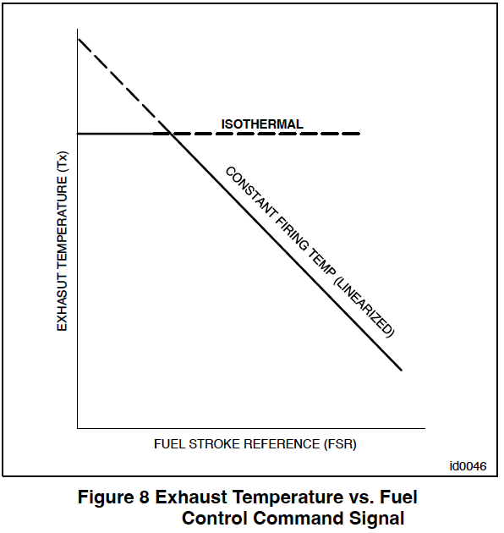

Slide 48
Exhaust Temperature Control Hardware
Chromel–Alumel exhaust temperature thermocouples are used and, typically 27 in number. These thermocouples circumferentially inside the exhaust diffuser.
They have individual radiation shields that allow the radial outward diffuser flow to pass over these 1/16” diameter (1.6mm) stainless steel sheathed thermocouples at high velocity, minimizing the cooling effect of the longer time constant, cooler plenum walls.
The signals from these individual, ungrounded detectors are sent to the SPEEDTRONIC Mark VI control panel through shielded thermocouple cables and are divided amongst controllers <RST>.

Slide 49
Exhaust Temperature Control Software
The software contains a series of application programs written to perform the exhaust temperature control and monitoring functions such as digital and analog input scan.
A major function is the exhaust temperature control, which consists of the following programs:
1. Temperature control command
2. Temperature control bias calculations
3. Temperature reference selection

Slide 50
Exhaust Temperature Control Software [conti.]
The temperature control software determines the scold junction compensated thermocouple readings, selects the temperature control setpoint, calculates the control setpoint value, calculates the representative exhaust temperature value, compares this value with the setpoint, and then generates a fuel command signal to the analog control system to limit exhaust temperature.

Slide 51
Temperature Control Command Program
The temperature control command program compares the exhaust temperature control setpoint with the measured gas turbine exhaust temperature as obtained from the thermocouples mounted in the exhaust plenum; these thermocouples are scanned and cold junction corrected by programs described later. These signals are accessed by <RST>.
The temperature control command program in <RST> (Figure 9) reads the exhaust thermocouple temperature values and sorts them from the highest to the lowest.

Slide 52
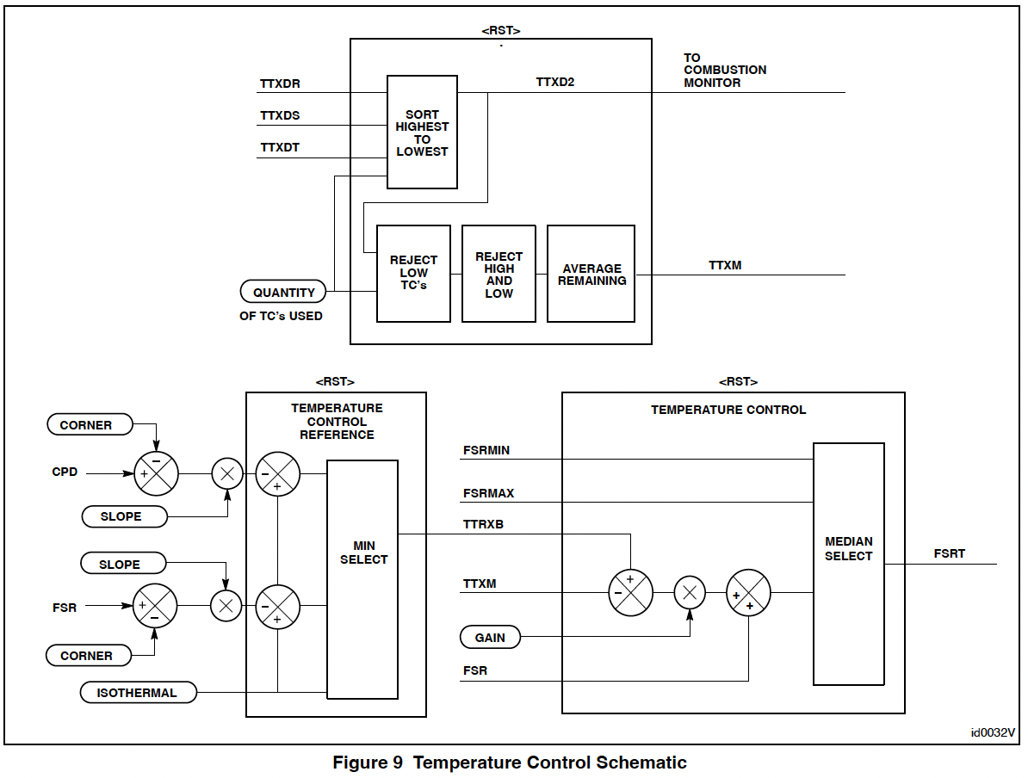

Slide 53
Temperature Control Command Program [conti.]
This array (TTXD2) is used in the combustion monitor program as well as in the Temperature Control Program.
In the Temperature Control Program all exhaust thermocouple inputs are monitored and if any are reading too low as compared to a constant, they will be rejected.
The highest and lowest values are then rejected and the remaining values are averaged, that average being the TTXM signal.
If a Controller should fail, this program will ignore the readings from the failed Controller. The TTXM signal will be based on the remaining Controllers’ thermocouples and an alarm will be generated.

Slide 54
Temperature Control Command Program [conti.]
The TTXM value is used as the feedback for the exhaust temperature comparator because the value is not affected by extremes that may be the result of faulty instrumentation.
The temperature–control–command program in <RST> compares the exhaust temperature control setpoint (calculated in the temperature–control–bias program and stored in the computer memory) TTRXB to the TTXM value to determine the temperature error.
The software program converts the temperature error to a fuel stroke reference signal, FSRT.

Slide 55
Temperature Control Bias Program
Gas turbine firing temperature is determined by the measured parameters of exhaust temperature and compressor discharge pressure (CPD) or exhaust temperature and fuel consumption (proportional to FSR).
In the computer, firing temperature is limited by a linearized function of exhaust temperature and CPD backed up by a linearized function of exhaust temperature and FSR (See Figure 8).
The temperature control bias program (Figure 10) calculates the exhaust temperature control setpoint TTRXB based on the CPD data stored in computer memory and constants from the selected temperature–reference table.
The program calculates another setpoint based on FSR and constants from another temperature– reference table.

Slide 56
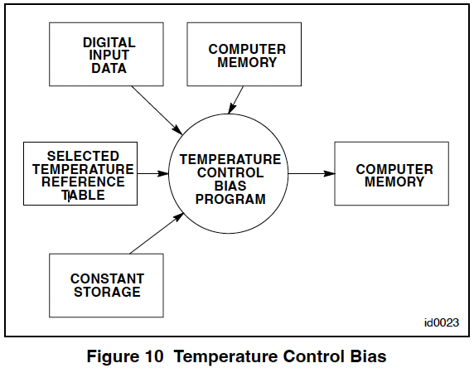

Slide 57
Temperature Control Bias Program [conti.]
Figure 11 is a graphical illustration of the control setpoints.
The constants TTKn_C (CPD bias corner) and TTKn_S (CPD bias slope) are used with the CPD data to determine the CPD bias exhaust tem-perature setpoint. The constants TTKn_K (FSR bias corner) and TTKn_M (FSR bias slope) are used with the FSR data to determine the FSR bias exhaust temperature setpoint.
The values for these constants are given in the Control Specifications–Control System Settings drawing.
The temperature–control–bias program also selects the isothermal setpoint TTKn_I. The program selects the minimum of the three setpoints, CPD bias, FSR bias, or isothermal for the final exhaust temperature control reference.
During normal operation with gas or light distillate fuels, this selection results in a CPD bias control with an isothermal limit, (as shown by the heavy lines on Figure 11)

Slide 58
Temperature Control Bias Program [conti.]
The CPD bias setpoint is compared with the FSR bias setpoint by the program and an alarm occurs when the CPD setpoint is higher.
For units operating with heavy fuel, FSR bias control will be selected to minimize the effect of turbine nozzle plugging on firing temperature.
The FSR bias setpoint will then be compared with the CPD bias setpoint and an alarm will occur when the FSR setpoint exceeds the CPD setpoint.
A ramp function is provided in the program to limit the rate at which the setpoint can change.
The maximum and minimum change in ramp rates (slope) are programmed in constants TTKRXR1 and TTKRXR2. Consult the Control Sequence Program (CSP) and the Control Specifications drawing for the block diagram illustration of this function and the value of the constants. Typical rate change limit is 1.5°F per second.
The output of the ramp function is the exhaust temperature control setpoint which is stored in the computer memory.

Slide 59
Temperature Reference Select Program
The exhaust temperature control function selects control setpoints to allow gas turbine operation at various firing temperatures.
The temperature–reference– select program (Figure 12) determines the operational level for control setpoints based on digital input information representing temperature control requirements.
Three digital input signals are decoded to select one set of constants which define the control setpoints necessary to meet those requirements.
A typical digital signal is “BASE SELECT”, selected by clicking on the appropriate target on the operator interface <HMI>.

Slide 60
FUEL CONTROL SYSTEM

Slide 61
FUEL CONTROL SYSTEM
The gas turbine fuel control system will change fuel flow to the combustors in response to the fuel stroke reference signal (FSR).
FSR actually consists of two separate signals added together
FSR1 being the called–for liquid fuel flow and
FSR2 being the called–for gas fuel flow
Normally, FSR1 + FSR2 = FSR.
Standard fuel systems are designed for operation with liquid fuel and/or gas fuel i.e., a dual fuel system.
The servo drive system, where the setpoint is compared with the feedback signal and converted to a valve position. (A dual system)
The FSR from the control systems is conditioned and sent as a set point to the servo system.

Slide 62
Servo Drive System
The heart of the fuel system is a three coil electro–hydraulic servovalve (servo) (Figure 13).
The servovalve
Is the interface between the electrical and mechanical systems
Controls the direction and rate of motion of a hydraulic actuator based on the input current to the servo.
Contains three electrically isolated coils on the torque motor.
Each coil is connected to one of the three Controllers <RST>, this provides redundancy should one of the Controllers or coils fail.
There is a null–bias spring which positions the servo so that the actuator will go to the fail safe position should ALL power and/or control signals be lost.

Slide 63
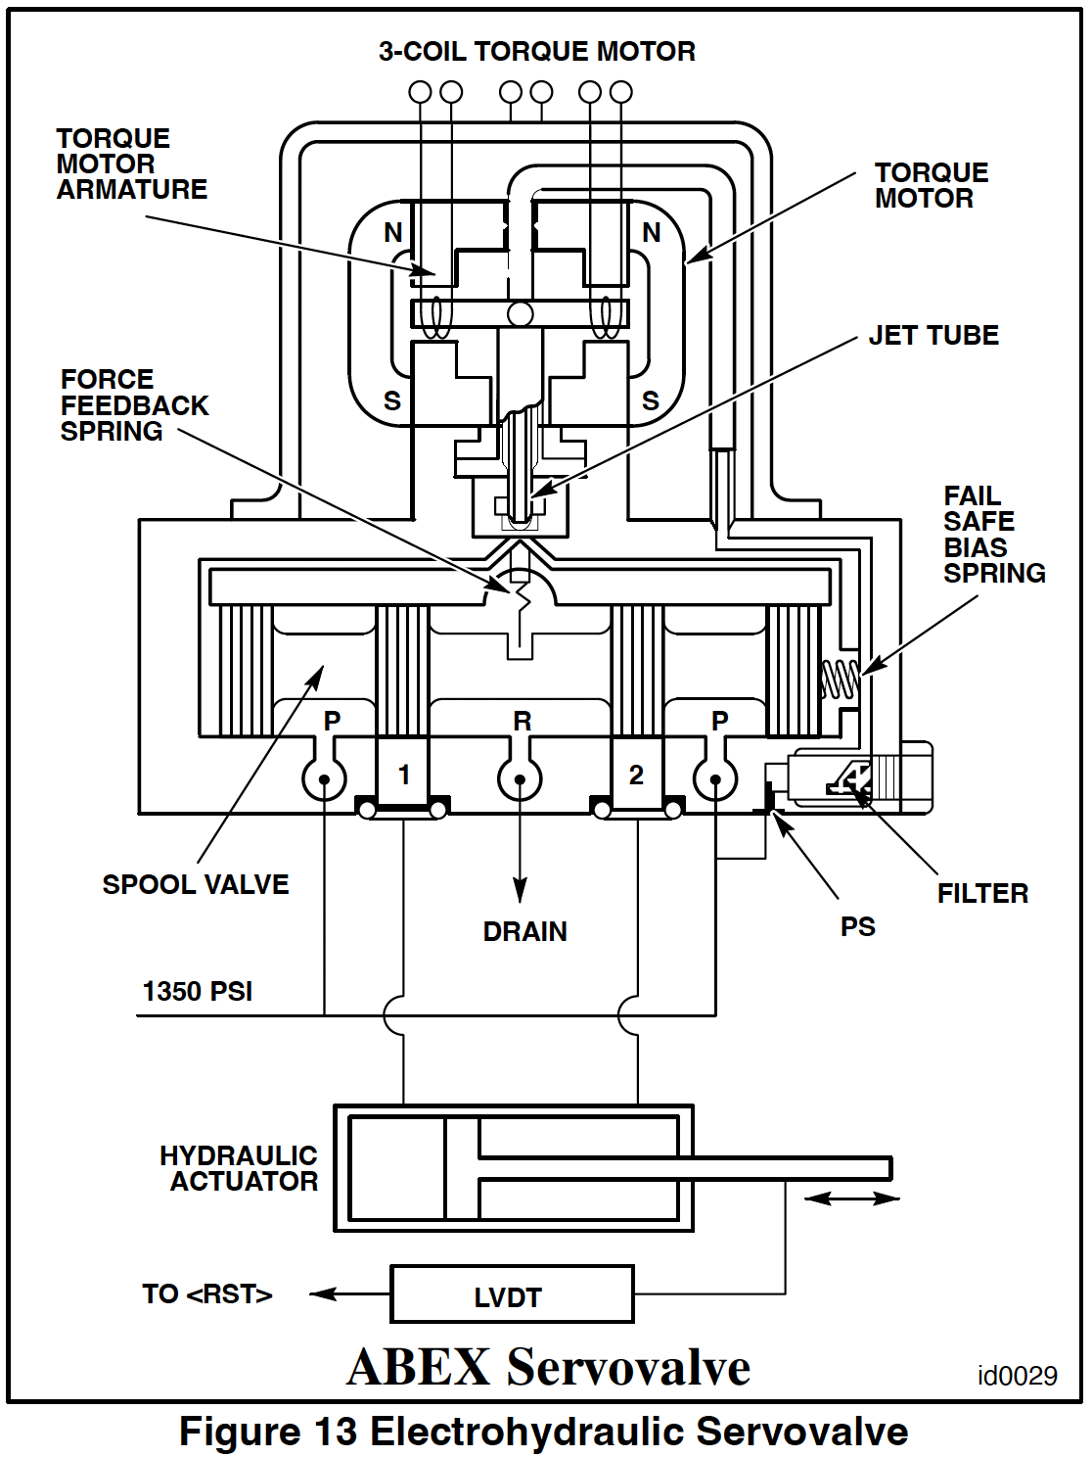

Slide 64
Servo Drive System [conti.]
If the hydraulic actuator is a double–action piston, the control signal positions the servovalve so that it ports high–pressure oil to either side of the hydraulic actuator.
If the hydraulic actuator has spring return, hydraulic oil will be ported to one side of the cylinder and the other to drain.
A feedback signal provided by a linear variable differential transformer (LVDT, Figure 13) will tell the control whether or not it is in the required position.
The LVDT outputs an AC voltage which is proportional to the position of the core of the LVDT, which in turn is connected to the valve whose position is being controlled
As the valve moves, the feedback voltage changes.
The LVDT requires an exciter voltage which is provided by the VSVO card.

Slide 65
Servo Drive System [conti.]
Figure 14 shows the major components of the servo positioning loops.
The digital (microprocessor signal) to analog conversion is done on the VSVO card
This represents called–for fuel flow.
The called–for fuel flow signal is then compared to a feedback representing actual fuel flow.
The difference is amplified on the VSVO card and sent through the TSVO card to the servo. This output to the servos is monitored and there will be an alarm on loss of any one of the three signals from <RST>.

Slide 66
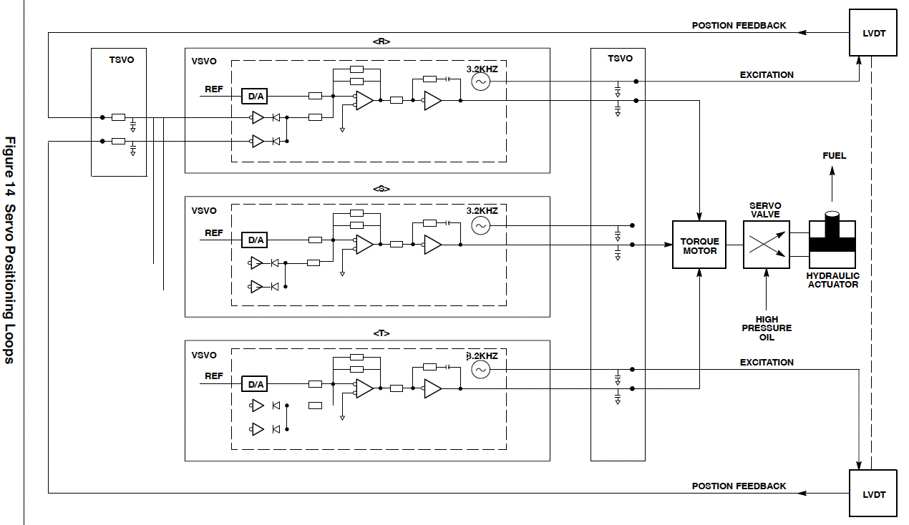

Slide 67
Liquid Fuel Control
The liquid fuel system consists of fuel handling components and electrical control components.
Some of the fuel handling components are:
Primary fuel oil filter
Fuel oil stop valve
Three fuel pumps
Fuel bypass valve
Fuel pump pressure relief valve
Flow divider
Combined selector valve/pressure gauge assembly
False start drain valve
Fuel lines, and
Fuel nozzles.

Slide 68
Liquid Fuel Control [conti.]
The electrical control components are:
liquid fuel pressure switch (upstream) 63FL–2
fuel oil stop valve limit switch 33FL
liquid fuel pump bypass valve servovalve 65FP
flow divider magnetic speed pickups 77FD–1, –2, –3 and
SPEEDTRONIC control cards TSVO and VSVO.
A diagram of the system showing major components is shown in Figure 15.
The fuel bypass valve
Is a hydraulically actuated valve with a linear flow characteristic.
Located between the inlet (low pressure) and discharge (high pressure) sides of the fuel pump
Bypasses excess fuel delivered by the fuel pump back to the fuel pump inlet, delivering to the flow divider the fuel necessary to meet the control system fuel demand.
It is positioned by servo valve 65FP, which receives its signal from the controllers.

Slide 69
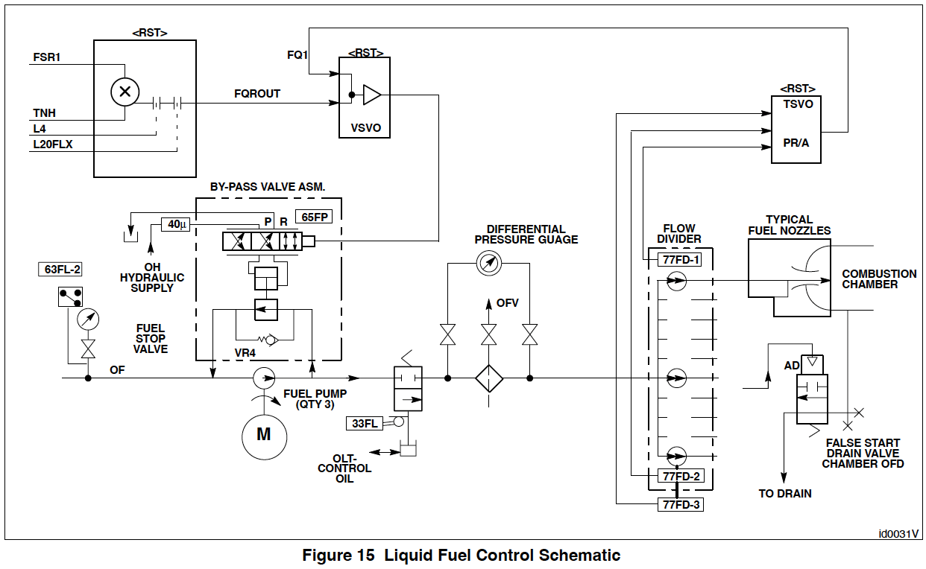

Slide 70
Liquid Fuel Control [conti.]
The flow divider
Divides the single stream of fuel from the pump into several streams, one for each combustor.
It consists of a number of matched high volumetric efficiency positive displacement gear pumps, again one per combustor.
Is driven by the small pressure differential between the inlet and outlet.
The gear pumps are mechanically connected so that they all run at the same speed
Making the discharge flow from each pump equal.
Fuel flow is represented by the output from the flow divider magnetic pickups (77FD–1, –2 & –3).
These are non–contacting magnetic pickups, which give a pulse signal frequency proportional to flow divider speed, which is proportional to the fuel flow delivered to the combustion chambers.

Slide 71
Liquid Fuel Control [conti.]
The TSVO card receives the pulse rate signals from 77FD–1, –2, and –3 and outputs an analog signal which is proportional to the pulse rate input.
The VSVO card modulates servovalve 65FP based on inputs of
Turbine speed
FSR1 (called–for liquid fuel flow), and
Flow divider speed (FQ1).

Slide 72
Fuel Oil Control – Software
When the turbine is run on liquid fuel oil, the control system checks the permissives L4 and L20FLX and does not allow FSR1 to close the bypass valve unless they are ‘true’ (closing the bypass valve sends fuel to the combustors).
The L4 permissive comes from the Master Protective System and L20FLX becomes ‘true’ after the turbine vent timer times out.
These signals control the opening and closing of the fuel oil stop valve.

Slide 73
Fuel Oil Control – Software [conti.]
The FSR signal from the controlling system goes through the fuel splitter where the liquid fuel requirement becomes FSR1.
The FSR1 signal is multiplied by TNH, so fuel flow becomes a function of speed – an important feature, particularly while the unit is starting.
This enables the system to have better resolution at the lower, more critical speeds where air flow is very low.
This produces the FQROUT signal, which is the digital liquid fuel flow command. At full speed TNH does not change, therefore FQROUT is directly proportional to FSR.

Slide 74
Fuel Oil Control – Software [conti.]
FQROUT then goes to the VSVO card where it is changed to an analog signal to be compared to the feedback signal from the flow divider.
As the fuel flows into the turbine, speed sensors 77FD–1, –2, and –3 send a signal to the TSVO card, which in turn outputs the fuel flow rate signal (FQ1) to the VSVO card.
When the fuel flow rate is equal to the called– for rate (FQ1 = FSR1)
The servovalve 65FP is moved to the null position and
The bypass valve remains “stationary” until some input to the system changes.
If the feedback is in error with FQROUT, the operational amplifier on the VSVO card will change the signal to servovalve 65FP to drive the bypass valve in a direction to decrease the error.

Slide 75
Fuel Oil Control – Software [conti.]
The flow divider feedback signal
Is also used for system checks.
Is an analog signal is converted to digital counts and is used in the controller’s software
To compare to certain limits as well as
To display fuel flow on the <HMI>.
The checks made are as follows:
L60FFLH:Excessive fuel flow on start–up
L3LFLT1:Loss of LVDT position feedback
L3LFBSQ:Bypass valve is not fully open when the stop valve is closed.
L3LFBSC:Servo current is detected when the stop valve is closed.
L3LFT:Loss of flow divider feedback

Slide 76
Fuel Oil Control – Software [conti.]
If L60FFLH (Excessive fuel flow on start–up check) is true for a specified time period (nominally 2 seconds), the unit will trip
if L3LFLT1 (Loss of LVDT position feedback) through L3LFT (Loss of flow divider feedback) are true, these faults will trip the unit during start–up and require manual reset.

Slide 77
Gas Fuel Control
The dry low NOx II (DLN–2) control system regulates the distribution of gas fuel to a multi–nozzle combustor arrangement.
The fuel flow distribution to each fuel nozzle assembly is a function of
Combustion reference temperature (TTRF1) and
IGV temperature control mode.
By a combination of fuel staging and shifting of combustion modes from diffusion at ignition through premix at higher loads, low nitrous oxide (NOx) emissions are achieved.

Slide 78
Gas Fuel Control [conti.]
Fuel gas is controlled by the
Gas stop/speed ratio valve (SRV),
Primary, secondary and quaternary gas control valves (GCV) , and
Premix splitter valve (PMSV).
The premix splitter valve controls the split between secondary and tertiary gas flow.
All valves are servo controlled by signals from the SPEEDTRONIC control panel (Figure 16).

Slide 79
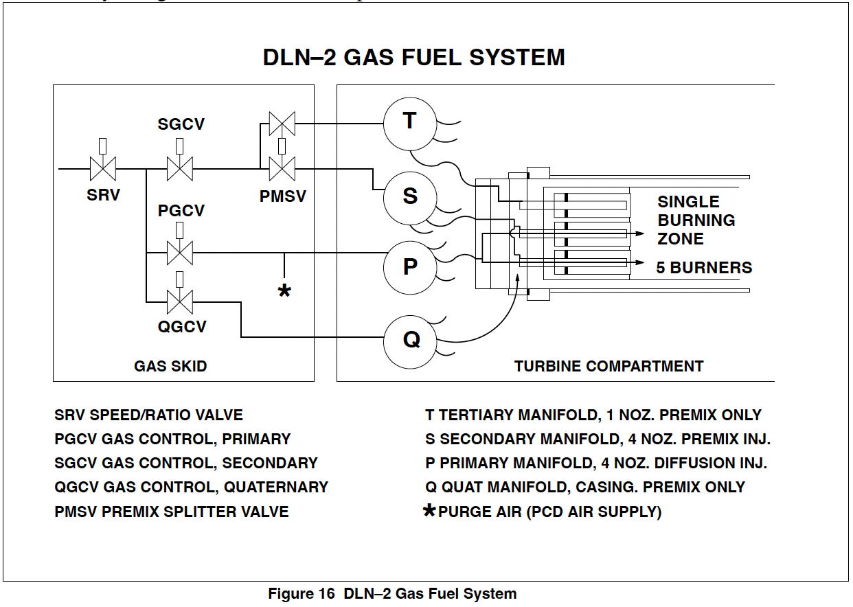

Slide 80
Gas Fuel Control [conti.]
It is the gas control valve which controls the desired gas fuel flow in response to the command signal FSR.
To enable it to do this in a predictable manner, the speed ratio valve is designed to maintain a predetermined pressure (P2) at the inlet of the gas control valve as a function of gas turbine speed.
There are three main DLN–2 combustion modes:
Primary
Lean–Lean
Premix

Slide 81
Gas Fuel Control [conti.]
Primary mode exists from light off to 81% corrected speed
With fuel flow to primary nozzles only
Lean–Lean is from 81% corrected speed to a preselected combustion reference temperature
With fuel to the primary and tertiary nozzles.
In Premix operation – fuel is directed to secondary, tertiary and quaternary nozzles.
Minimum load for this operation is set by
Combustion reference temperature and
IGV position.

Slide 82
Gas Fuel Control [conti.]
The fuel gas control system consists primarily of the following components:
Gas strainer
Gas supply pressure switch 63FG
Stop/speed ratio valve assembly
Fuel gas pressure transducer(s) 96FG
Gas fuel vent solenoid valve 20VG
Control valve assembly
LVDT’s 96GC–1, –2, –3, –4, –5, –6, 96SR–1, –2, 96 PS–1, –2
Electro–hydraulic servovalves 90SR, 65GC and 65PS
Dump valve(s) VH–5
Three pressure gauges
Gas manifold with ‘pigtails’ to respective fuel nozzles, and
SPEEDTRONIC control cards TBQB and TCQC. (Shown schematically in Figure 17)

Slide 83
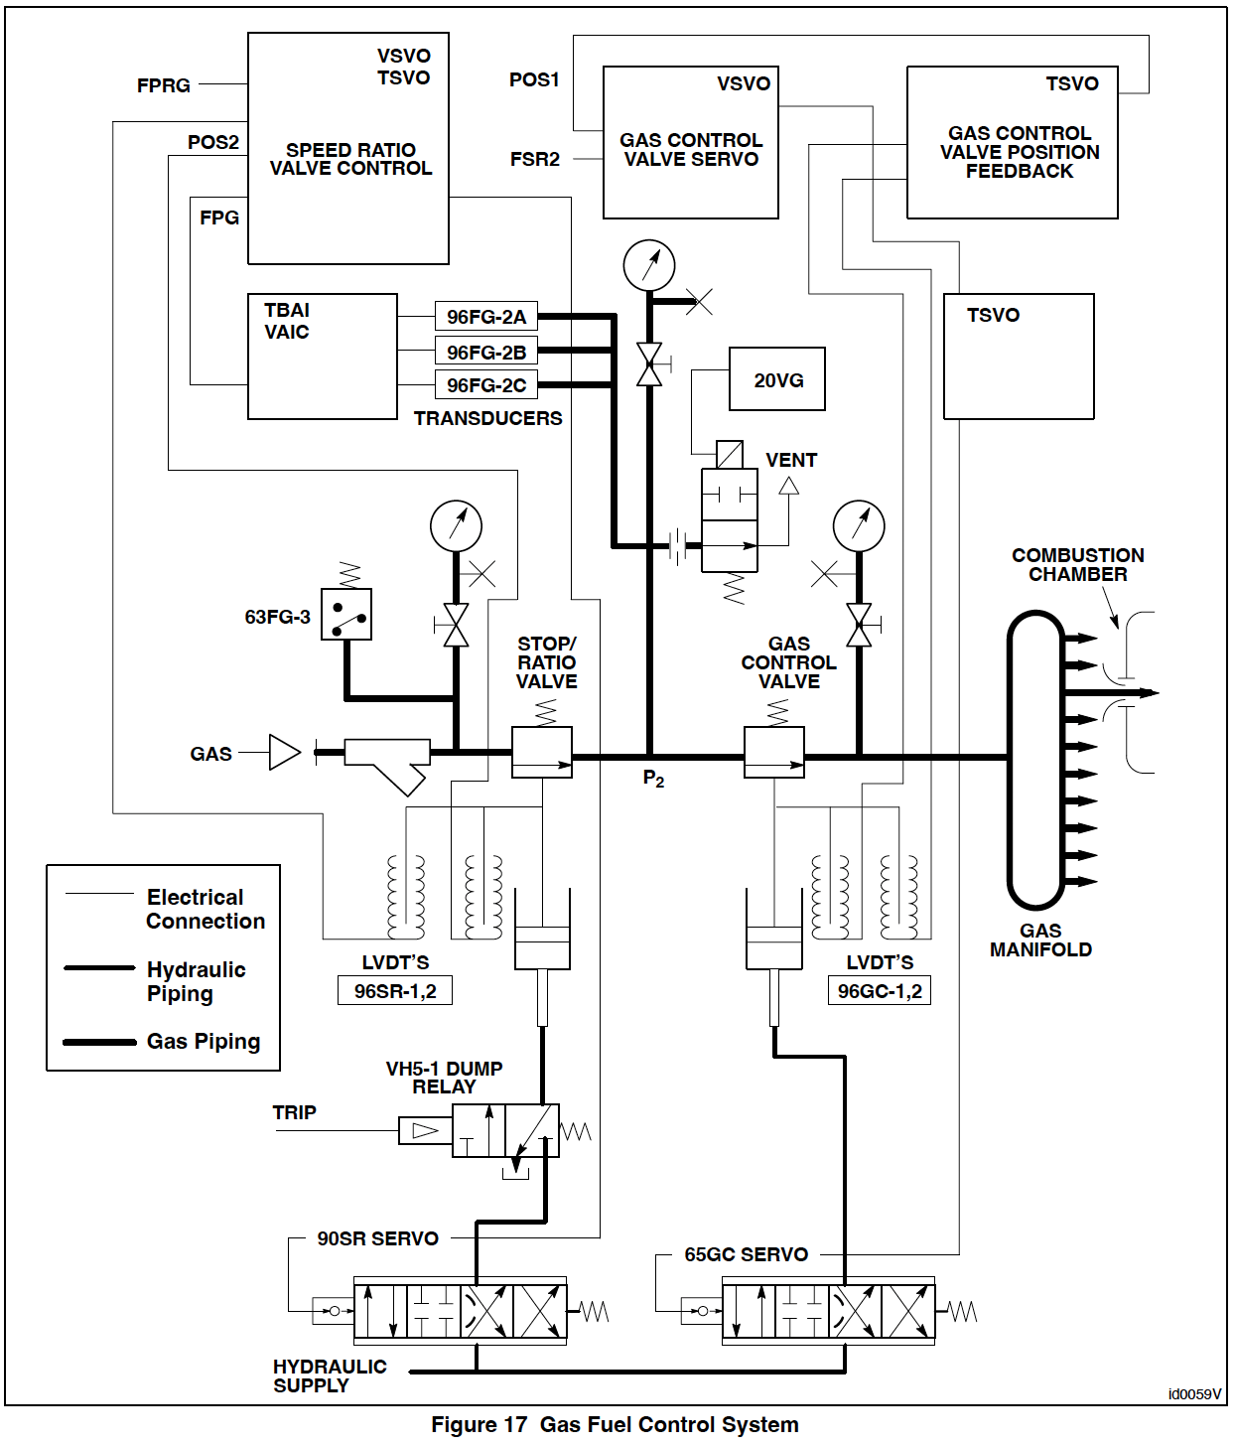

Slide 84
Gas Control Valves
The position of the gas control valve plug is intended to be proportional to FSR2 which represents called–for gas fuel flow.
Actuation of the spring–loaded gas control valve is by a hydraulic cylinder controlled by an electro–hydraulic servovalve.
When the turbine is to run on gas fuel the permissives L4, L20FGX and L2TVX (turbine purge complete) must be ‘true’, similar to the liquid system.
This allows the Gas Control Valve to open. The stroke of the valve will be proportional to FSR.

Slide 85
Gas Control Valves [conti.]
FSR goes through the fuel splitter where the gas fuel requirement becomes FSR2, which is then conditioned for offset and gain.
This signal, FSROUT, goes to the VSVO card where it is converted to an analog signal and then output to the servo valve through the TSVO card.
The gas control valve stem position is sensed by the output of a linear variable differential transformer (LVDT) and fed back through the TSVO card to an operational amplifier on the VSVO card where it is compared to the FSROUT input signal at a summing junction.

Slide 86
Gas Control Valves [conti.]
There are two LVDTs providing feedback
Two of the three controllers are dedicated to one LVDT each, while the third selects the highest feedback through a high–select diode gate.
If the feedback is in error with FSROUT, the operational amplifier on the VSVO card will change the signal to the hydraulic servovalve
To drive the gas control valve in a direction to decrease the error.
In this way
The desired relationship between position and FSR2 is maintained and
The control valve correctly meters the gas fuel. (Figure 18).

Slide 87
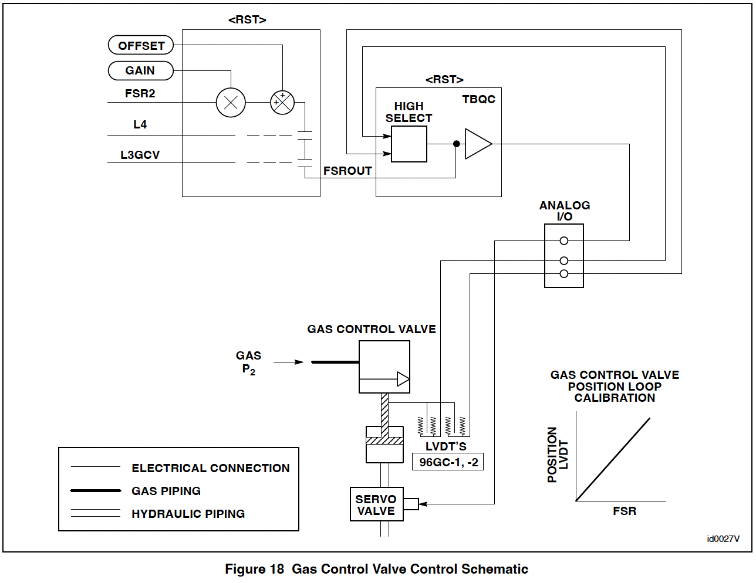

Slide 88
Gas Control Valves [conti.]
The plug in the gas control valve is contoured to provide the proper flow area in relation to valve stroke.
The gas control valve uses a skirted valve disc and venturi seat to obtain adequate pressure recovery.
High pressure recovery occurs at overall valve pressure ratios substantially less than the critical pressure ratio.
The net result is that flow through the control valve is independent of valve pressure drop.
Gas flow then is a function of valve inlet pressure P2 and valve area only.
An open or a short circuit in one of the servo coils or in the signal to one coil does not cause a trip.
Each GCV has two LVDTs and can run correctly on one.

Slide 89
Stop/Speed Ratio Valve
The speed ratio/stop valve is a dual function valve.
It serves as a pressure regulating valve to hold a desired fuel gas pressure ahead of the gas control valve and it also serves as a stop valve. As a stop valve it is an integral part of the protection system.
Any emergency trip or normal shutdown will move the valve to its closed position shutting off gas fuel flow to the turbine. This is done either by
Dumping hydraulic oil from the Stop/Speed Ratio Valve VH–5 hydraulic trip relay (or)
Driving the position control closed electrically.

Slide 90
Stop/Speed Ratio Valve [conti.]
The stop/speed ratio valve has two control loops. There is a position loop similar to that for the gas control valve and there is a pressure control loop. (Figure 19).
Fuel gas pressure P2 at the inlet to the gas control valve is controlled by the pressure loop as a function of turbine speed. This is done by proportioning it to turbine speed signal TNH, with an offset and gain, which then becomes Gas Fuel Pressure Reference FPRG.
FPRG then goes to the VSVO card to be converted to an analog signal.
P2 pressure is measured by 96FG which outputs a voltage proportional to P2 pressure.
This P2 signal (FPG) is compared to the FPRG and the error signal (if any) is in turn compared with the 96SR LVDT feedback to reposition the valve as in the GCV loop.

Slide 91
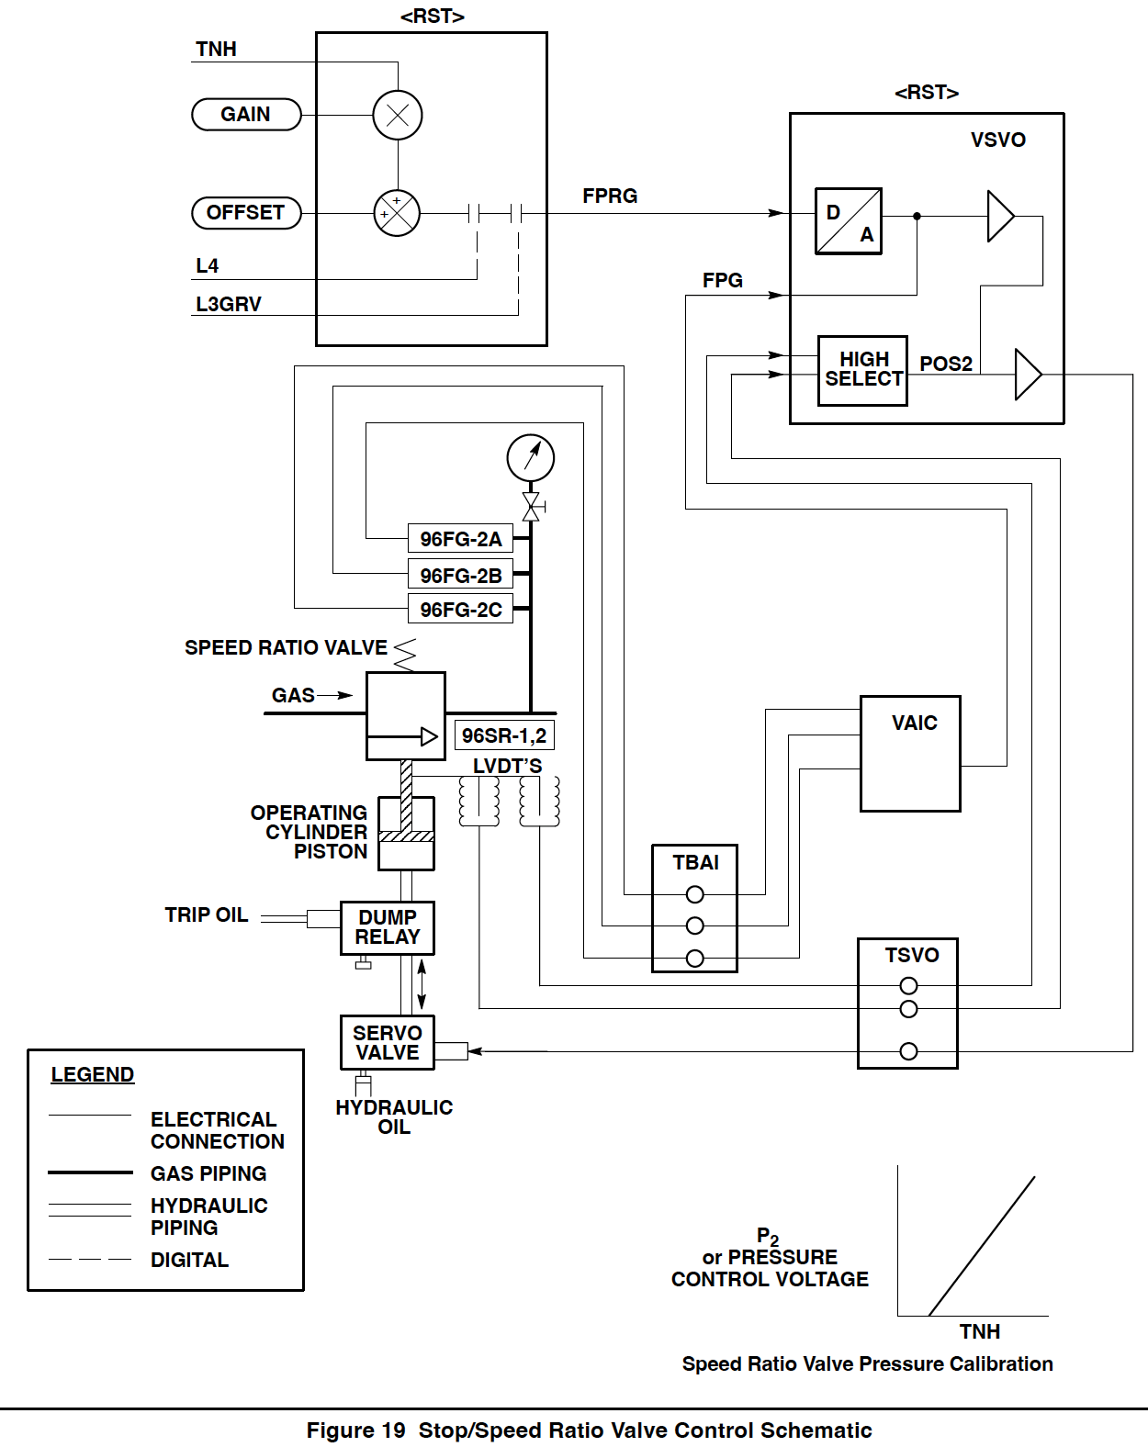

Slide 92
Stop/Speed Ratio Valve [conti.]
The stop/speed ratio valve provides a positive stop to fuel gas flow when required by a normal shut– down, emergency trip, or a no–run condition.
Hydraulic trip dump valve VH–5 is located between the electro–hydraulic servovalve 90SR and the hydraulic actuating cylinder. This dump valve is operated by the low pressure control oil trip system.
If permissives L4 and L3GRV are ‘true’ the trip oil (OLT) is at normal pressure and the dump valve is maintained in a position that allows servovalve 90SR to control the cylinder position.

Slide 93
Stop/Speed Ratio Valve [conti.]
When the trip oil pressure is low (as in the case of normal or emergency shutdown), the dump valve spring shifts a spool valve to a position which dumps the high pressure hydraulic oil (OH) in the speed ratio/stop valve actuating cylinder to the lube oil reservoir.
The closing spring atop the valve plug instantly shuts the valve, thereby shutting off fuel flow to the combustors.

Slide 94
Stop/Speed Ratio Valve [conti.]
In addition to being displayed, the feedback signals and the control signals of both valves are compared to normal operating limits, and if they go outside of these limits there will be an alarm.
Typical alarms:
L60FSGH: Excessive fuel flow on start–up
L3GRVFB: Loss of LVDT feedback on the SRV
L3GRVO: SRV open prior to permissive to open
L3GRVSC: Servo current to SRV detected prior to permissive to open
L3GCVFB: Loss of LVDT feedback on the GCV
L3GCVO: GCV open prior to permissive to open
L3GCVSC: Servo current to GCV detected prior to permissive to open
L3GFIVP: Intervalve (P2) pressure low

Slide 95
Stop/Speed Ratio Valve [conti.]
The servovalves are furnished with a mechanical null offset bias
To cause the gas control valve or speed ratio valve to go to the zero stroke position (fail safe condition) should the servovalve signals or power be lost.
During a trip or no–run condition, a positive voltage bias is placed on the servo coils holding them in the ‘valve closed’ position.

Slide 96
Premix Splitter Valve
The Premix splitter valve (PMSV) regulates the split of secondary/tertiary gas fuel flow between the secondary and tertiary gas fuel manifolds.
The valve is referenced to the secondary fuel passages, i.e. 0% valve stroke corresponds to 0% secondary fuel flow.
Unlike the SRV and GCV’s the flow through the splitter valve is not linear with valve position.
The control system linearizes the fuel split setpoint and the resulting valve position command FSRXPOUT is used as the position reference.

Slide 97
Dual Fuel Control
Turbines that are designed to operate on both liquid and gaseous fuel are equipped with controls to provide the following features:
Transfer from one fuel to the other on command.
Allow time for filling the lines with the type of fuel to which turbine operation is being transferred.
Operation of liquid fuel nozzle purge when operating totally on gas fuel.
Operation of gas fuel nozzle purge when operating totally on liquid fuel.
(The software diagram for the fuel splitter is shown in Figure 20.)

Slide 98
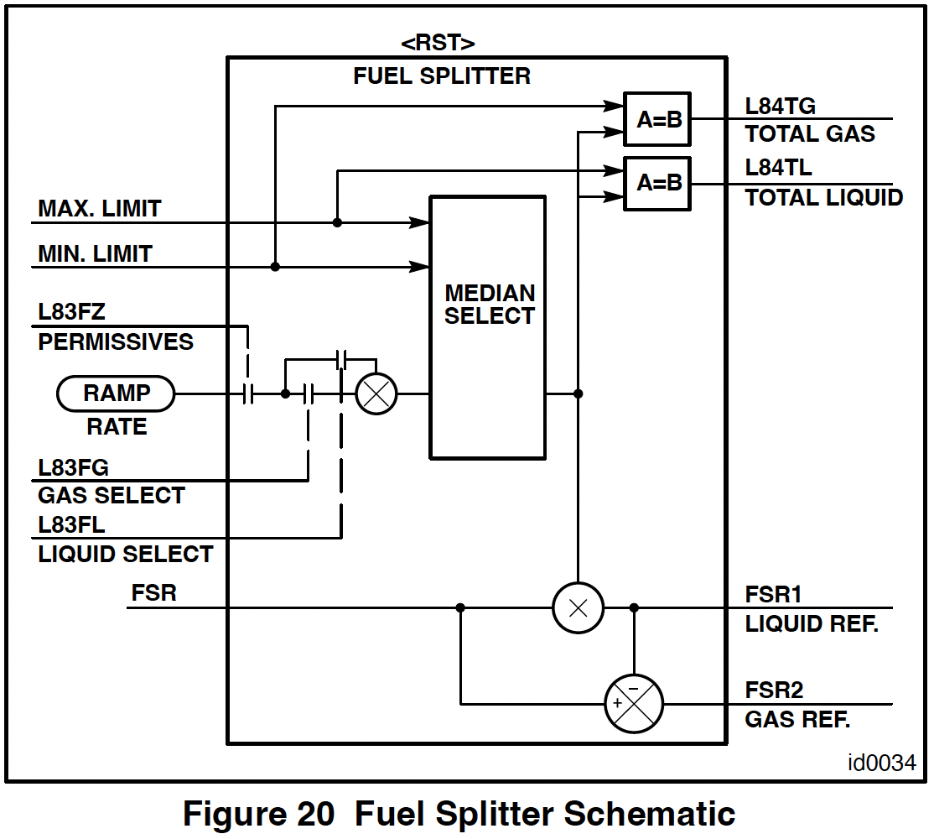

Slide 99
Fuel Splitter
FSR is divided into two signals, FSR1 and FSR2, to provide dual fuel operation. (Figure 20)
FSR is multiplied by the liquid fuel fraction FX1 to produce the FSR1 signal. FSR1 is then subtracted from the FSR signal resulting in FSR2, the control signal for the secondary fuel.

Slide 100
Fuel Transfer – Liquid to Gas
If the unit is running on liquid fuel (FSR1) and the “GAS” target on the <HMI> screen is selected the following sequence of events will take place, providing the transfer and fuel gas permissives are true (refer to Figure 21):
FSR1 will remain at its initial value, but FSR2 will step to a value slightly greater than zero, usually 0.5%.
This will open the gas control valve slightly to bleed down the inter-valve volume.
This is done in case a high pressure has been entrained.
The presence of a higher pressure than that required by the speed/ratio controller would cause slow response in initiating gas flow.

Slide 101
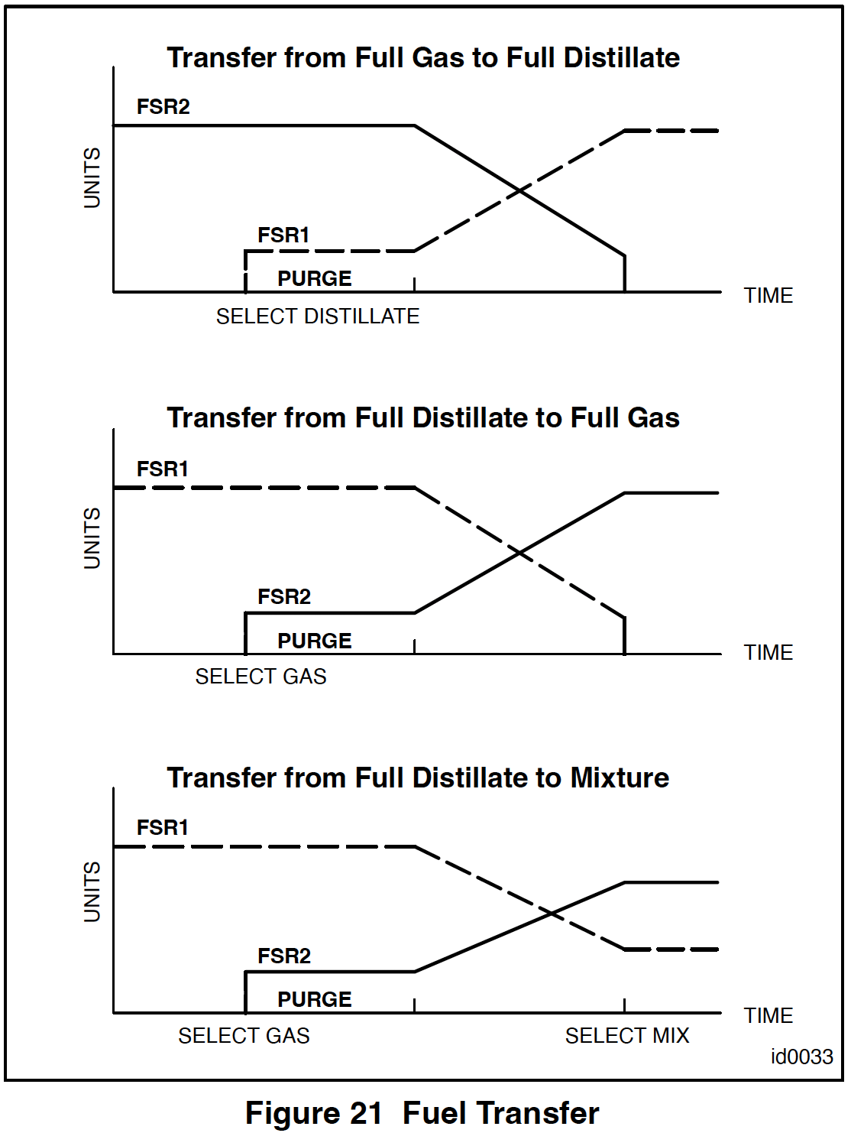

Slide 102
Fuel Transfer – Liquid to Gas [conti.]
A typical time delay of thirty seconds occurs to
Bleed down the P2 pressure and
Fill the gas supply line
Then the software program ramps the fuel commands, FSR2 to increase and FSR1 to decrease, at a programmed rate through the median select gate.
This is completed in thirty seconds.
When the transfer is complete logic signal L84TG (Total Gas) will
De–energize the liquid fuel forwarding pump
Close the fuel oil stop valve by de–energizing the liquid fuel dump valve 20FL
Initiate the purge sequence.

Slide 103
Liquid Fuel Purge
To prevent coking of the liquid fuel nozzles while operating on gas fuel, some atomizing air is diverted through the liquid fuel nozzles.
The following sequence of events occurs when transfer from liquid to gas is complete.
Air from the atomizing air system flows through
cooler (HX4–1)
Fuel oil purge valve (VA19–3)
Check valve VCK2 to each fuel nozzle.
The fuel oil purge valve is controlled by the position of a solenoid valve 20PL–2 .
When this valve is energized, actuating air pressure opens the purge oil check valve, allowing air flow to the fuel oil nozzle purge check valves.

Slide 104
Fuel Transfer – Gas to Liquid
Transfer from gas to liquid is essentially the same sequence as previously described, except that gas and liquid fuel command signals are interchanged.
For instance, at the beginning of a transfer, FSR2 remains at its initial value, but FSR1 steps to a value slightly greater than zero.
This will command a small liquid fuel flow.
If there has been any fuel leakage out past the check valves, this will fill the liquid fuel piping and avoid any delay in delivery at the beginning of the FSR1 increase.
The rest of the sequence is the same as liquid–to– gas, except that there is usually no purging sequence.

Slide 105
Gas Fuel Purge
Primary gas fuel purge
is required during
premix steady state
liquid fuel operation.
This system involves a double block and bleed arrangement, wherby
Two purge valves (VA13–1, –2) are shut
when primary gas is flowing
Intervalve vent solenoid (20VG–2) is open
To bleed any leakage across the valves.
The purge valves are air operated through solenoid valves 20PG–1, –2.
When there is no primary gas flow, the purge valves open
And allow compressor discharge air to flow through the primary fuel nozzle passages.

Slide 106
Gas Fuel Purge [conti.]
Secondary purge is required for the secondary and tertiary nozzles when
Secondary and tertiary fuel flow is reduced to zero
Operating on liquid fuel
This is a block and bleed arrangement similar to the primary purge with:
Two purge valves (VA13–3, –4)
Intervalve vent solenoid (20VG–3)
Solenoid valves 20PG–3, –4.

Slide 107
MODULATED INLET GUIDE VANE SYSTEM

Slide 108
MODULATED INLET GUIDE VANE SYSTEM
The Inlet Guide Vanes (IGVs) modulate during:
The Acceleration of the gas turbine to rated speed,
Loading and Unloading of the generator, and
Deceleration of the gas turbine.
This IGV modulation maintains
Proper flows and pressures, and thus stresses, in the compressor
A minimum pressure drop across the fuel nozzles, and
When used in a combined cycle application, maintains high exhaust temperatures at low loads.

Slide 109
Guide Vane Actuation
The modulated inlet guide vane actuating system is comprised of the following components:
Servovalve 90TV
LVDT position sensors 96TV–1 and 96TV–2, and,
In some instances, solenoid valve 20TV and hydraulic dump valve VH3.
If used, they prevent hydraulic oil pressure from flowing to 90TV. (Figure 23)
Control of 90TV will port hydraulic pressure to operate the variable inlet guide vane actuator.

Slide 110
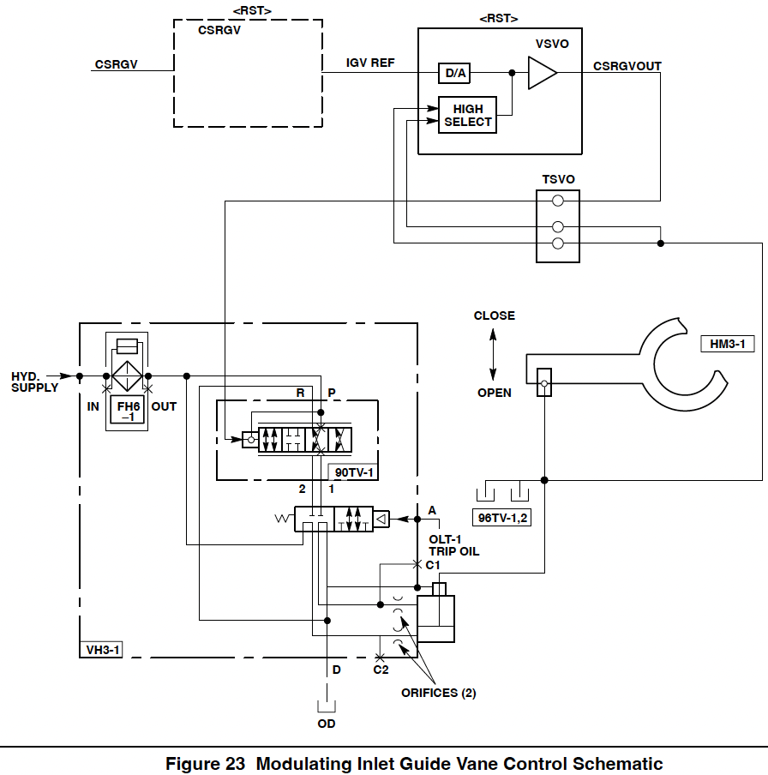

Slide 111
Operation
During start–up, the inlet guide vanes (IGVs) are held fully closed, A nominal 27 degree angle from zero to 83.5% corrected speed.
Turbine speed is corrected to reflect air conditions at 27° C (80° F); this compensates for changes in air density, as ambient conditions change.
At ambient temperatures greater than 80° F
Corrected speed TNHCOR is less than actual speed TNH;
At ambients less than 27° C (80° F)
TNHCOR is greater than TNH.
After attaining a speed of approximately 83.5%, the guide vanes will modulate open at about 6.7 degrees per percent increase in corrected speed.

Slide 112
Operation [conti.]
When the guide vanes reach the minimum full speed angle, nominally 54°, they stop opening
This is usually at approximately 91% TNH.
By not allowing the guide vanes to close to an angle less than the minimum full speed angle at 100% TNH
A minimum pressure drop is maintained across the fuel nozzles, thereby lessening combustion system resonance.
Solenoid valve 20CB is usually opened when the generator breaker is closed
This in turn closes the compressor bleed valves.

Slide 113
Operation [conti.]
As the unit is loaded and exhaust temperature increases, the inlet guide vanes (IGVs) will go to the full open position when the exhaust temperature reaches one of two points, depending on the operation mode selected.
For simple cycle operation, the IGVs move to the full open position at a pre–selected exhaust temperature, usually 371° C (700° F).
For combined cycle operation, the IGVs begin to move to the full open position as exhaust temperature approaches the temperature control reference temperature
Normally, the IGVs begin to open when exhaust temperature is within 17° C (30° F) of the temperature control reference.

Slide 114
Operation [conti.]
During a normal shutdown, as the exhaust temperature decreases the IGVs move to the minimum full speed angle
As the turbine decelerates from 100% TNH, the inlet guide vanes (IGVs) are modulated to the fully closed position.
When the generator breaker opens, the compressor bleed valves will be opened.
In the event of a turbine trip:
The compressor bleed valves are opened and
The inlet guide vanes (IGVs) go to the fully closed position and remain fully closed as the turbine continues to coast down.

Slide 115
Operation [conti.]
For under-speed operation, if TNHCOR decreases below approximately 91%, the inlet guide vanes (IGVs) modulate closed at 6.7 degrees per percent decrease in corrected speed.
In most cases, if the actual speed decreases below 95% TNH
The generator breaker will open
The turbine speed setpoint will be reset to 100.3%.
The IGVs will then go to the minimum full speed angle.(Figure 24.)

Slide 116
